Slide 1
Student Placement Prediction Using
Naive Bayes Algorithm
Presented By
Guided By

Slide 2
Abstract
One of the biggest challenges that higher learning institutions face today is to improve the placement performance of students. Admission and reputation of institutions mainly depends on placements. Hence all institutions strive to strengthen placement department. All student’s dream is to obtain a job offer in their hands before they leave their college. Educational institutes look for more efficient technology that assist better management and support decision making procedures or assist them to set new strategies. Placement predictor system could predict the type of company a student has chances to be placed. It helps the students to have an idea about where they stand and what to be done to obtain a good placement. In this Project, student placement prediction model has been proposed that uses Naive Bayes algorithm to identify the placement chance of students. This model helps the placement cell within an organization to identify the prospective students and pay attention to and improve their technical as well as interpersonal skills. With this model, students can put in more hard work for getting placed in to the companies that belong to higher hierarchies.

Slide 3
Hardware Requirements
Processor : Processor Intel CORE i3 and above
Internet Connection : Existing telephone lines, Data card, Fiber net
RAM : 4 GB
Software Requirements
Operating System : Windows, Mac, Linux
Language : R Programming – R-4.1.3
GUI : RStudio

Slide 4
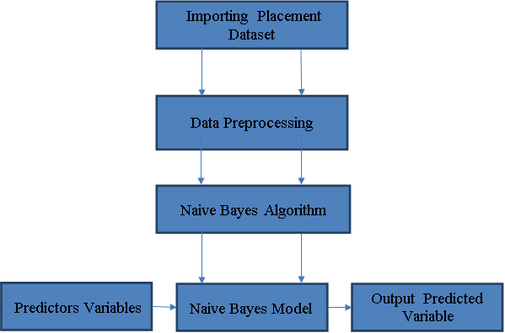
Architectural Diagram

Slide 5
Project Modules
There are four Modules
Importing Placement dataset
Data Preprocessing
Model Generation Using Naive Bayes Algorithm
Prediction using Naive Bayes Model

Slide 6
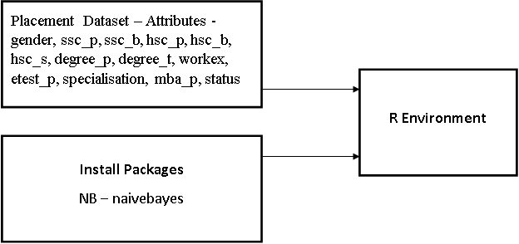
Importing Placement Dataset
Data have to be imported in to R environment for analysis.
Data can be any format like txt, .csv, .xlsx, .SPSS etc.
Package necessary for Naive Bayes algorithm have to be installed and loaded in to the program. NB – naivebayes

Slide 7
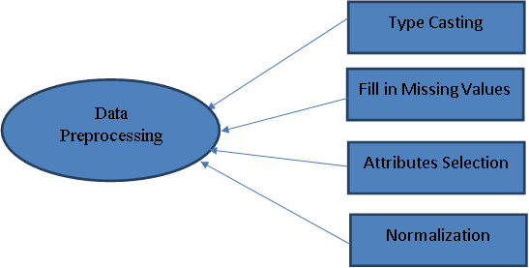
Data Preprocessing
In Data Preprocessing, it is not necessary to hold all the attributes for doing the analysis, we can hold only the attributes which is affecting the analysis.
.

Slide 8
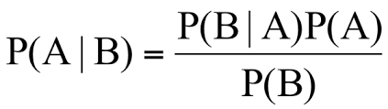
Model Generation Using Naive Bayes Algorithm
Naive Bayes is a classification and prediction algorithm based on Bayes Theorem.
Bayes Theorem
P(A|B) - Probability of occurrence of event A given the event B is true - Posterior Probability
P(A) - Probabilities of the occurrence of event A - Class prior Probability
P(B) - Probabilities of the occurrence of event B – Predictor Prior Probability
P(B|A) - Probability of the occurrence of event B given the event A is true - Likelihood

Slide 9
Model Generation Using Naive Bayes Algorithm
Steps in Naive Bayes algorithm
Step 1: Convert the data set into a frequency table
Step 2: Create Likelihood table by finding the probabilities values of each attributes
Step 3: Now, use Naive Bayesian equation to calculate the posterior probability for each class. The class with the highest posterior probability is the outcome of prediction.

Slide 10
Model Generation Using Naive Bayes Algorithm
Day | Outlook | Temp | Humidity | Windy | Play Ball
1 | Sunny | Hot | High | Weak | No
2 | Sunny | Hot | High | Strong | No
3 | Overcast | Hot | High | Weak | Yes
4 | Rain | Mild | High | Weak | Yes
5 | Rain | Cool | Normal | Weak | Yes
6 | Rain | Cool | Normal | Strong | No
7 | Overcast | Cool | Normal | Strong | Yes
8 | Sunny | Mild | High | Weak | No
9 | Sunny | Cool | Normal | Weak | Yes
10 | Rain | Mild | Normal | Weak | Yes
11 | Sunny | Mild | Normal | Strong | Yes
12 | Overcast | Mild | High | Strong | Yes
13 | Overcast | Hot | Normal | Weak | Yes
14 | Rain | Mild | High | Strong | No
Outlook |  |  | Temp |  |  | Humidity |  |  | Windy |  |  | Play Ball
 | Y | N |  | Y | N |  | Y | N |  | Y | N | Y | N
Sunny | 2 | 3 | Hot | 2 | 2 | High | 3 | 4 | Weak | 6 | 2 | 9 | 5
Overcast | 4 | 0 | Mild | 4 | 2 | Normal | 6 | 1 | Strong | 3 | 3
Rainy | 3 | 2 | Cool | 3 | 1
Sunny | 2/9 | 3/5 | Hot | 2/9 | 2/5 | High | 3/9 | 4/5 | Weak | 6/9 | 2/5 | 9/14 | 5/14
Overcast | 4/9 | 0/5 | Mild | 4/9 | 2/5 | Normal | 6/9 | 1/5 | Stg | 3/9 | 3/5
Rainy | 3/9 | 2/5 | Cool | 3/9 | 1/5
P(S,C,H,S) = P(S)*P(C)*P(H)*P(S)
= 5/14 * 4/14 *7/14*6/14 = 0.0216
Likelihood for Yes = 2/9 * 3/9 * 3/9* 3/9 = 0.0082
Likelihood for No = 3/5 * 1/5 * 4/5* 3/5 = 0.0576
Posterior Probability of Yes = (0.0082* 9/14) / 0.0216 =0.245
Posterior Probability of No = (0.0576 * 5/14) / 0.0216 =0.952
The posterior probability for the No is higher, so the probability of no is higher.
Bayes Theorem
Sunny, Cool, High, Strong
P(Yes |S,C,H,S) = P(S,C,H,S | Yes) *P(Yes) / P(S,C,H,S)
P(No | S,C,H,S) = P(S,C,H,S | No) *P(No) / P(S,C,H,S)

Slide 11

Prediction using Naive Bayes Model
Once Naive Bayes model have been created,
By using testing data, model can be evaluated
By giving only predictor variables, target variable can be predicted.

Slide 12
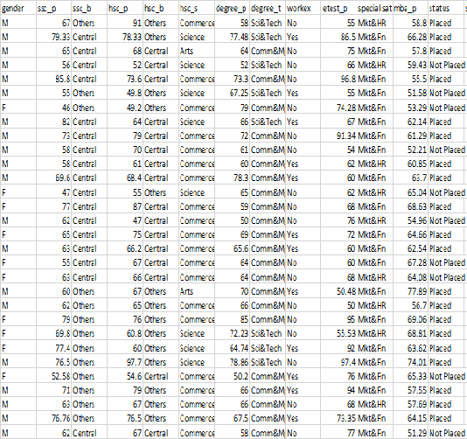
Naive Bayes Model
Sample Data Sets

Slide 13
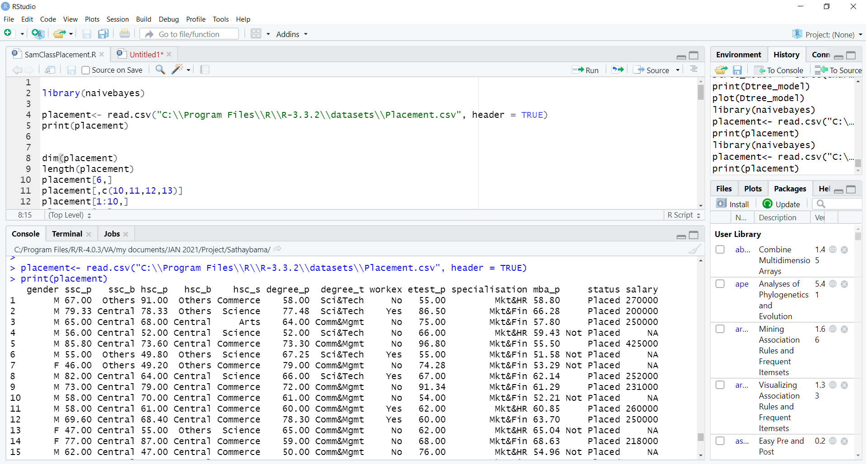
Naive Bayes Model
Data Importing

Slide 14
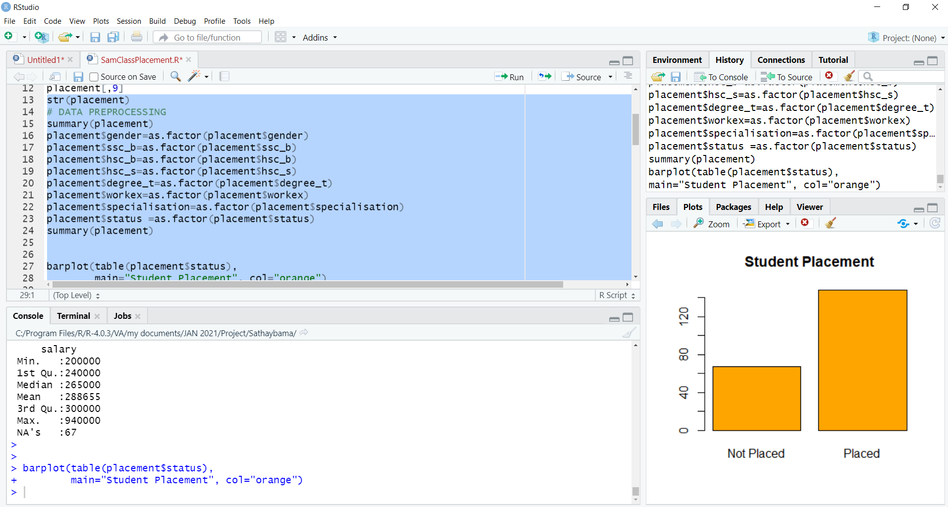
Naive Bayes Model
Data Preprocessing

Slide 15
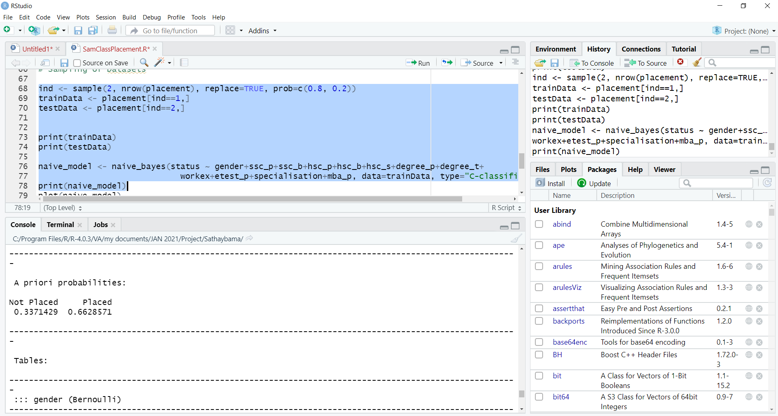
Naive Bayes Model
Naive Bayes Classification Model

Slide 16
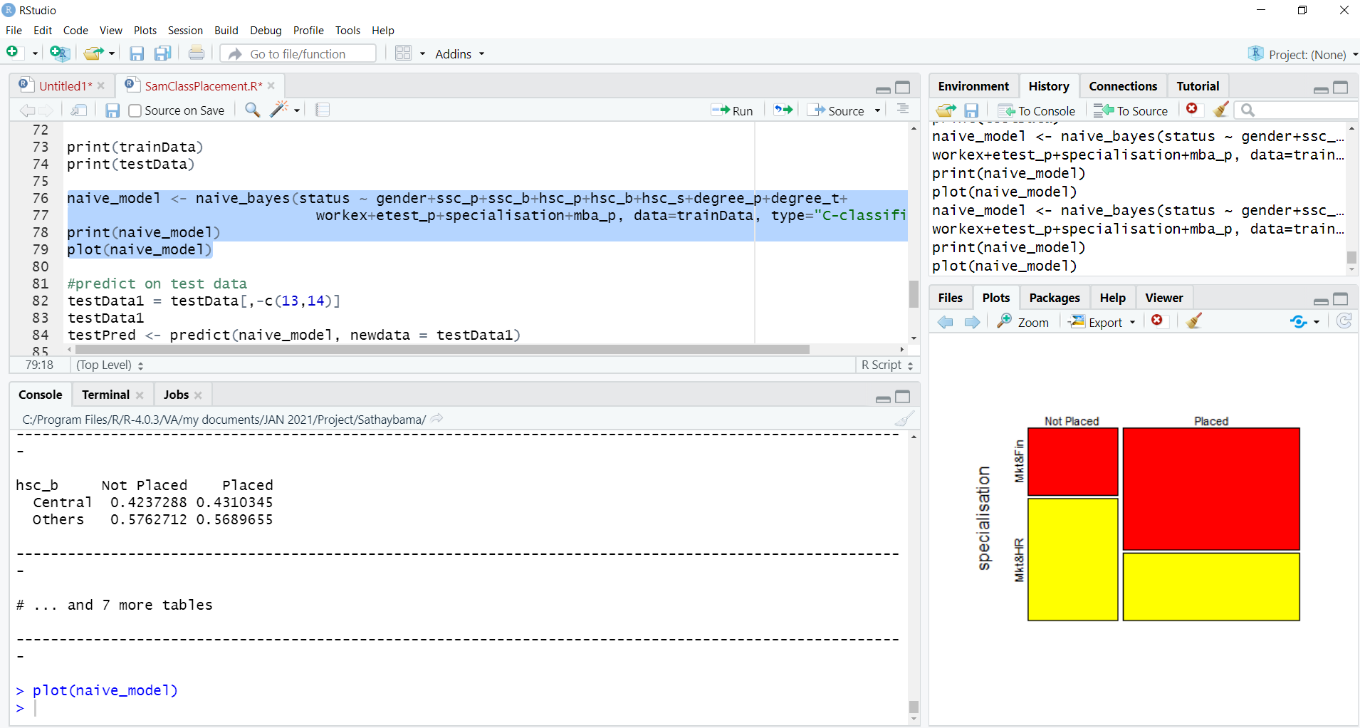
Naive Bayes Model
Naive Bayes Classification Model

Slide 17
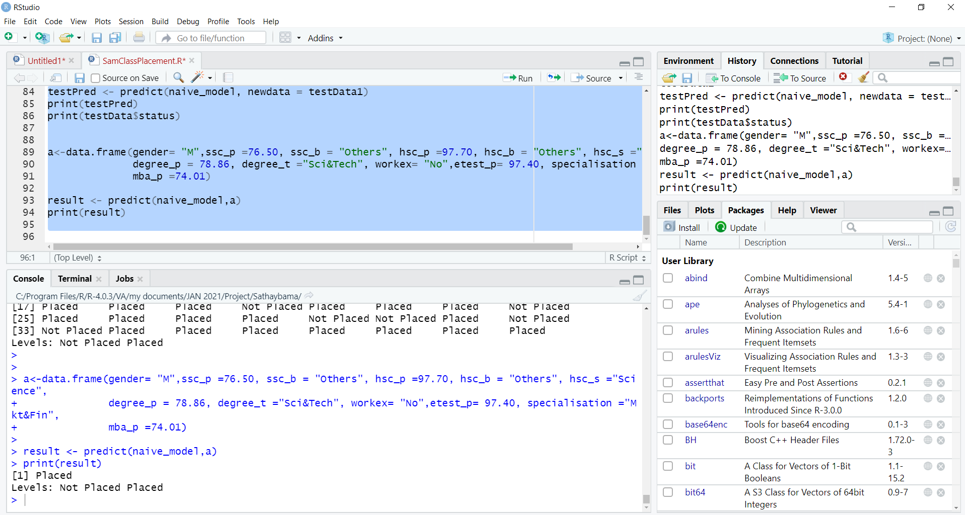
Naive Bayes Predictive Model

Slide 18
This project presents a recommendation system that uses Data Science algorithm for predicting, the student placement. The Naive Bayes Data Science algorithm is used for predicting the placement of students in a company. The students in pre-final and final years of their course can also use this system to know their individual placement status that they are most likely to achieve. This application endows the targeted group of students to boost their placement probability. Thus, this project concludes, Naive Bayes Algorithm performs better and faster when compared to other statistical techniques. This project can be further extended using some more data science algorithm and deep learning algorithms to improve the performance of prediction system.
Conclusion
Notes:
18

Slide 19
1. Tadi Aravind,“ A Comparative Study on Machine Learning Algorithms for Predicting the Placement Information of Under Graduate Students", IEEE International conference on I-SMAC,2019 2. Kanika Thakur, “Ensemble method to predict impact of student intelligent quotient and academic achievement on placement", IEEE International Conference on Intelligent Engineering and Management, 2021 3. Jinny Rhee; Sheri Sheppard, " Supporting student career development of undergraduate engineering", IEEE Frontiers in Education Conference (FIE), 2017. 4. Jaime Ramírez Castillo; Aldabbagh Ghadah, “Towards improved student placement and preparation methods on information technologies post-secondary education", IEEE Federated Conference on Computer Science and Information Systems, 2013. 5. Liya Claire Joy, “ A Review on Student Placement Chance Prediction“ IEEE International Conference on Advanced Computing & Communication Systems, 2019.
References
Notes:
19

